Slide 1
Evidence Based Lawmaking: The Climb Towards Full Scope of Practice
Deeb D. Eid, Pharm.D., RPh
Regulatory Affairs Advisor
WMSHP 2022

Slide 2
Learning Objectives:
Pharmacists
Pharmacy Technician
Identify and recognize updates or changes to laws, regulations, and practice models in relation to scope of practice for various states across the country.
Interpret and consider application of "full scope of practice" through an evidence-based analysis.
Differentiate barriers to full scope and recognize how each prevents moving towards a higher level of practice.
Recall updates to laws, regulations, and practice models in relation to pharmacy technician scope of practice for various states across the country.
Examine and analyze "full scope of practice" for pharmacy teams through an evidence-based analysis.
Identify the barriers to full scope of technician practice and recognize how each prevents moving towards a higher level.

Slide 3
The 3 Big Ideas
Pharmacy Practice is highly regulated which limits scope of practice
Law and rule changes must be vetted using an evidenced based analysis
The enforcement philosophy for laws and rules impacts scope of practice

Slide 4
Pre-Learning Assessment Check #1
Name a pharmacy scope of practice advancement within the last 1-2 years outside of Michigan

Slide 5
Today’s Agenda
EBL Analysis of Regs/Legs
SOC/BLR and Licensure
Summary
Barriers to Full Scope

Slide 6
Bright-Line Rules
Standard of Care
Clearly defined/objective
Leaves little or no room for varying interpretation
Defines forbidden and permissible conduct
Can be punitive
Using skills, prudence, and diligence as similar professionals or licensees of similar education, training, and experience
Assessed on a case-by-case basis to determine malpractice case rulings
Room for interpretation/subjective
Can be inclusive/wholistic
Pharmacy
Most other health
professions

Slide 7
1 Adams AJ

Slide 8
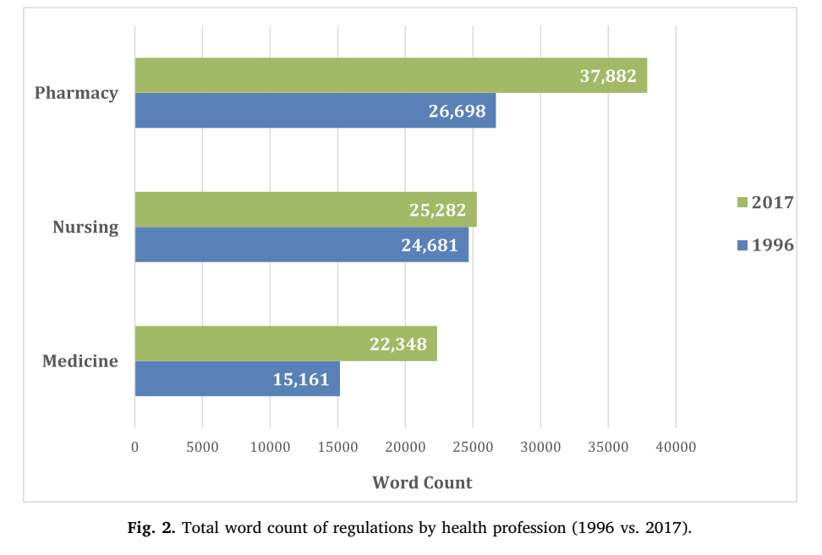
1 Adams AJ

Slide 9
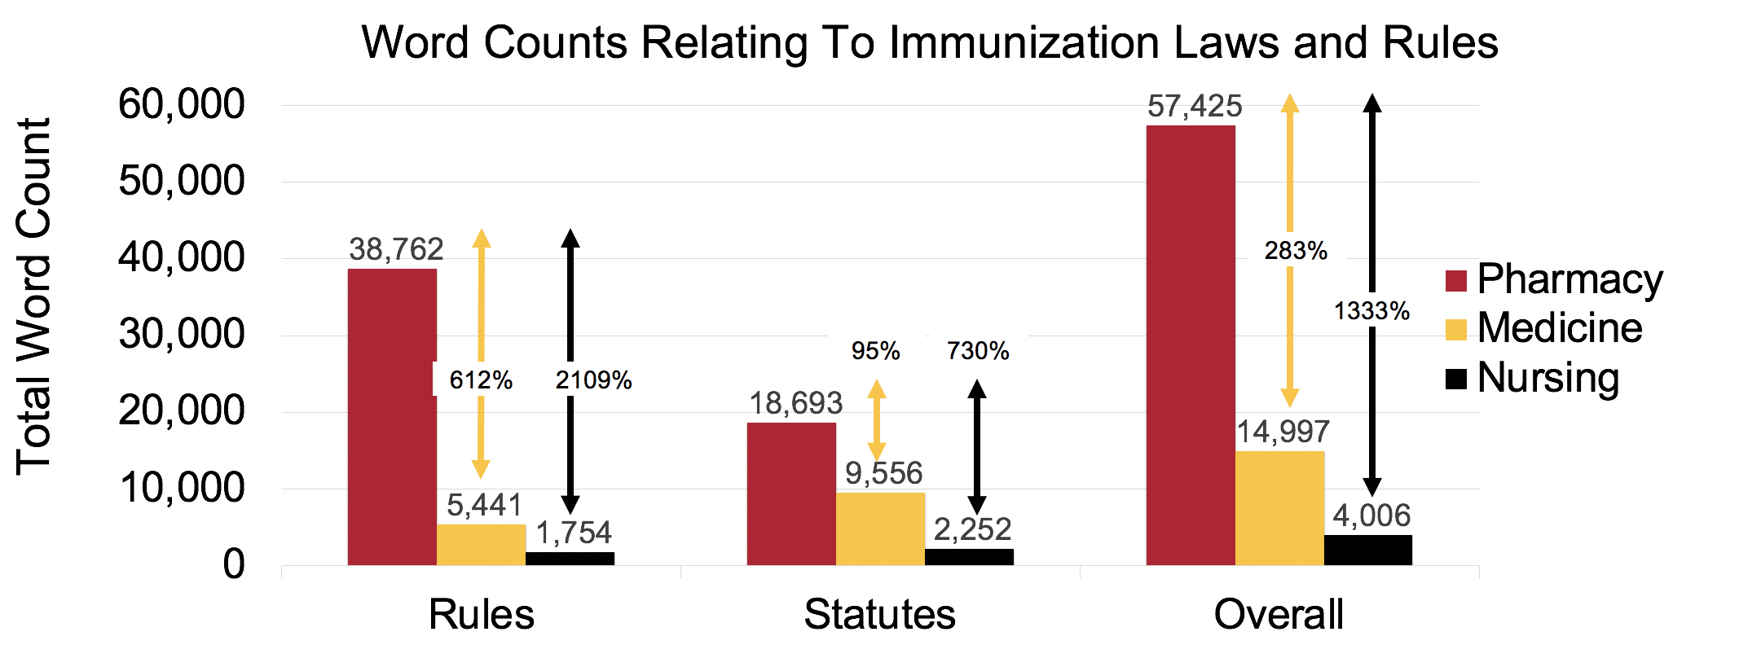
2 Eid et al. NABP Poster

Slide 10
Michigan Regulations (Administrative Code)³
Pharmacy
6 docs
103 pgs.
Nursing
2 docs
Medicine/Surgery
3 docs
47 pgs.
55 pgs.

Slide 11
Lowest Common Denominator
Model
Tiered Licensure Model
Legal Ceiling for Advanced Credentials
Skills
&
Abilities
Legal Ceiling
(“Top of License”)
Scope of Practice
Entry Barrier (Minimal Competence)
Practitioner A
Practitioner B
Practitioner C

Slide 12
Standard of Care/Ability-Based Model
Legal Ceiling
(“Top of License”)
Skills
&
Abilities
Scope of Practice
Entry Barrier (Minimal Competence)
Practitioner A
Practitioner B
Practitioner C

Slide 13
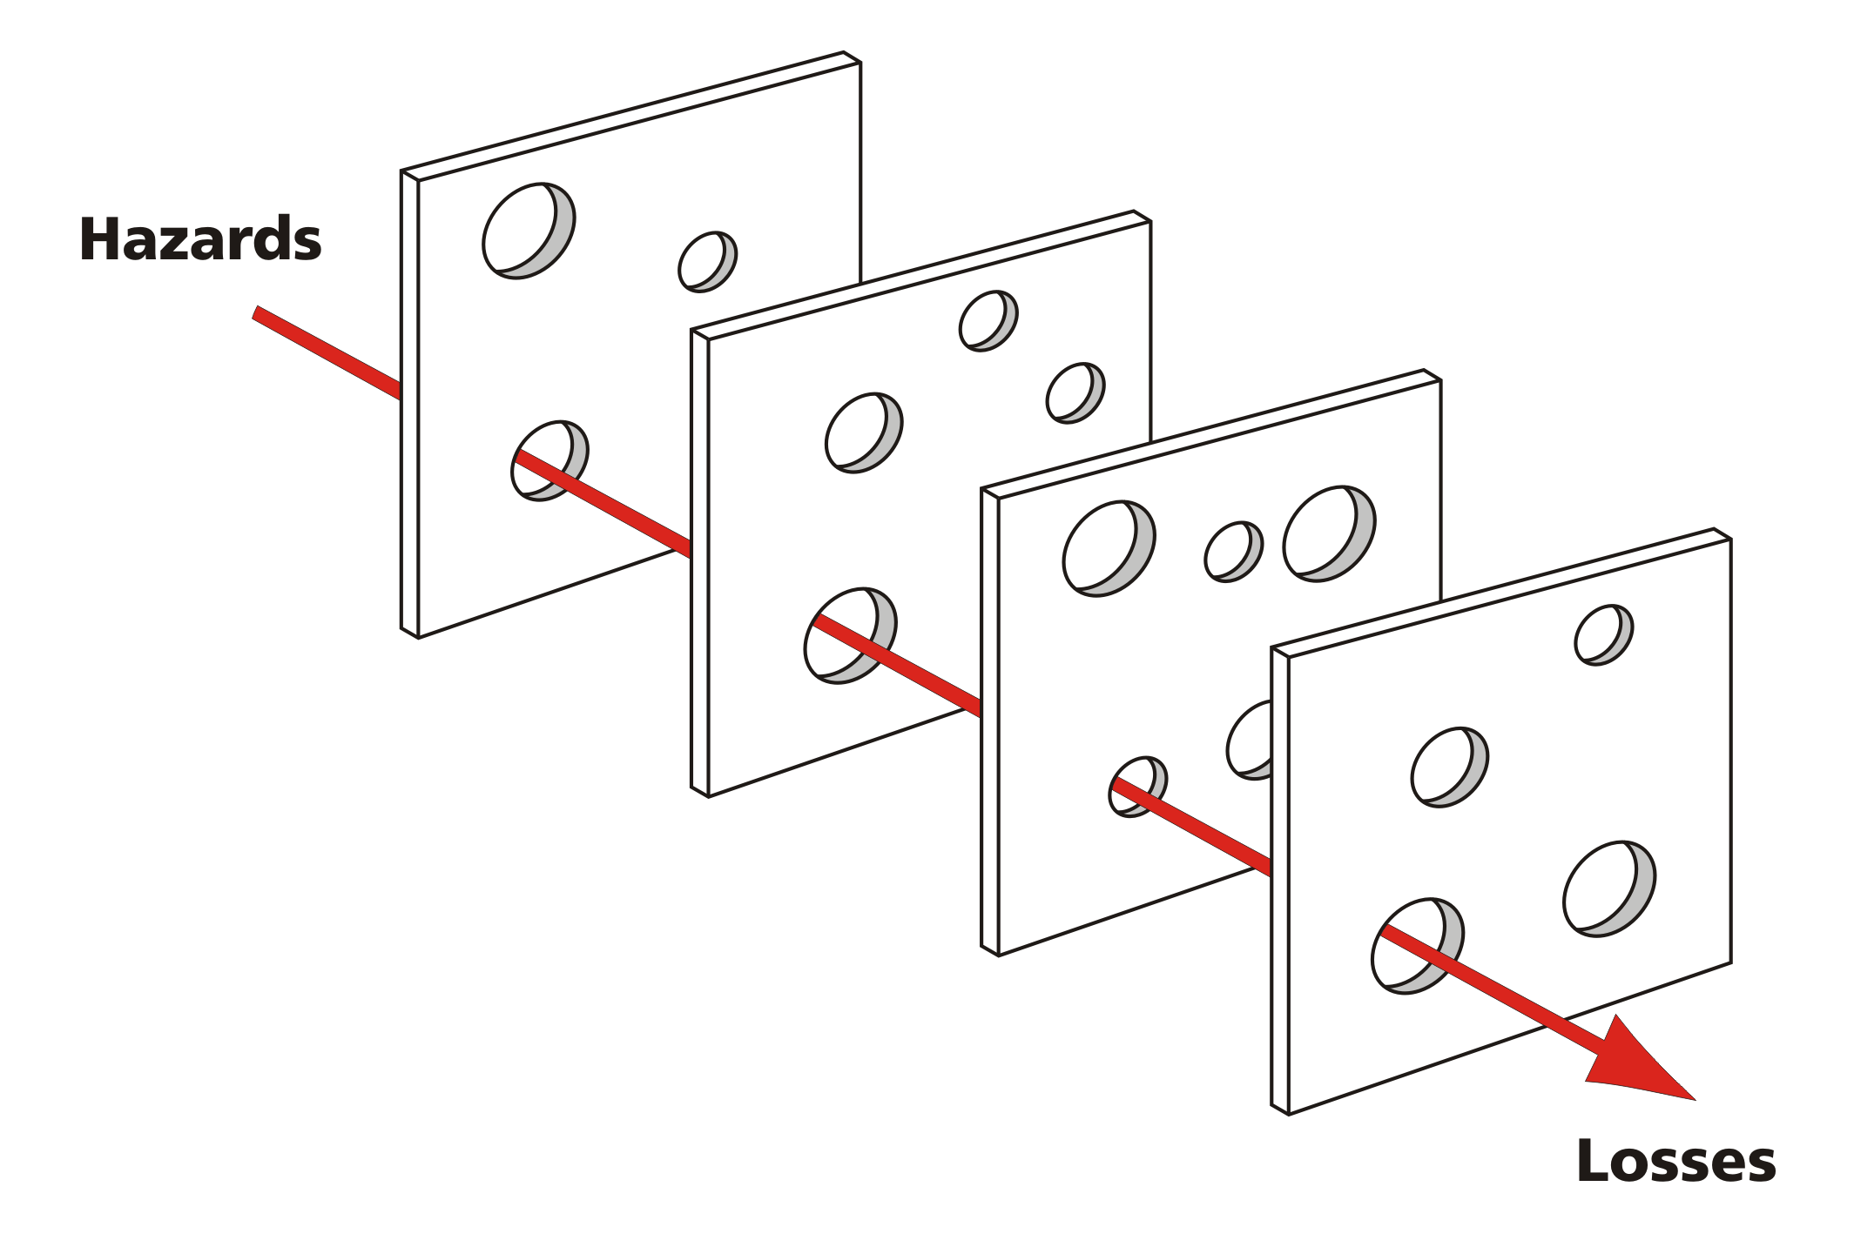
Why Does This Matter?
Systemic Failures
Emotions/Politics
Pacing Problem
Standard of care
Regulatory capture
Lack of knowledge
Provide patients with the highest level of care

Slide 14
Learning Assessment Case
Background: Patient M.K. presents to pharmacy for the first time seeking an albuterol inhaler to be given to them without a prescription because they have had it before from another pharmacy in the past and there is an emergency need for it. Pharmacist provides M.K. with an inhaler to help alleviate potential emergency, then calls the patient’s physician to seek a prescription for documentation afterwards.
Issue: The physician’s nurse notifies them of the scenario and the physician decides to call the board of pharmacy to file a report of breach of law on behalf of the pharmacist who issued the inhaler without a valid prescription.

Slide 15
Learning Assessment Case
Facts of the case:
Patient suffers from asthma, which they treat with prescription albuterol
When M.K. went to the pharmacy for the first time, she pleads to the pharmacist she was suffering from an acute asthmatic attack and had run out of her inhaler
Patient did not have a valid prescription for the Rx only product
Pharmacist, using their professional judgement, provided patient with the product
Pharmacist called the prescriber to pursue a valid prescription for dispensing after the fact the product had already left the store
As a result, patient did not suffer damage to her breathing, nor did she require hospitalization
Physician filed a report with the state board of pharmacy ensuing a breach of law requiring the board to investigate

Slide 16
Learning Assessment Case
Case Analysis:
Compare and contrast using bright line rules VS standard of care enforcement strategies.
How might the state board of pharmacy handle the report/breach of law?

Slide 17
Today’s Agenda
EBL Analysis of Regs/Legs
SOC/BLR and Licensure
Summary
Barriers to Full Scope

Slide 18
Out With The Old!⁴
Full Scope
Expanded Scope
Luxuries
“Nice to have”
Upgrades
Somehow optional
Proactive/comprehensive interventions
Patients should expect and be entitled to receive
Prevent or manage illness
Within an individual’s competency to perform independently.

Slide 19
Scope of Practice
Clinical/Technical Ability
The activities that a health professional are permitted to engage in as defined by state laws and regulations
Determined by the political process = geographical differences
One-size-fits all: applies to all professionals in class
Static (aside from law changes)
The true competence and ability of the health professional
Determined by education, training, career experience, and practice environment
Individualistic: recognizes professional heterogeneity
Dynamic; advances with new education, technology, etc.
MAY
CAN

Slide 20
Barriers to Full Scope
Emotions/Politics
Regulatory Capture
Lack of Awareness/Knowledge
Financial Tug of War
The Pacing Problem

Slide 21
Emotions⁵
“Insert Physician emotional comments”
“What evidence is there for/against?”
“Insert Pharmacist Advancement Here!”
“What opportunities does this present?”
Fight or Flight

Slide 22
Barriers to Full Scope
We are taught to use evidence-based
decision making in clinical practice, but
often use emotion-based decision making
in law/policy making.

Slide 23
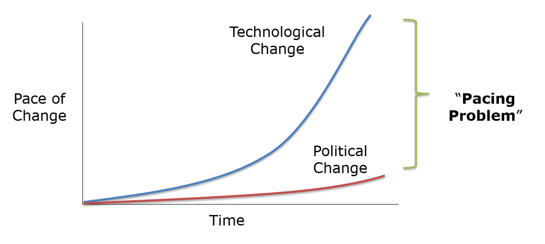
The Pacing Problem⁶ Technology changes exponentially; political systems change incrementally

Slide 24
Regulatory Capture⁷
Economic theory: regulatory agencies come to be dominated by the interests they regulate and not by the public interest.
Who seeks to gain or monetize by capturing the marketplace and regulating.

Slide 25
Regulatory Capture Examples
Mandatory CE
CPA/RX Authority → Medical Board
Accreditation for Education (Monopolized)
Mileage restrictions for Telepharmacy
CPAs-mandatory patient referral from physician
RPh Licensure Exams (Monopolized)

Slide 26
Today’s Agenda
EBL Analysis of Regs/Legs
SOC/BLR and Licensure
Summary
Barriers to Full Scope

Slide 27
“Shouldn’t the full scope of pharmacist practice be defined by evidence, not outdated and restrictive legislation and policy that differ across provinces and workplaces?”
4 Ross et al.

Slide 28
Evidence Based Law Analysis
Evidence
Legislation/Regulations
Education/Training
Maintaining patient safety: harmonizing scope with abilities
Insert Ability/Role

Slide 29
Disclaimer: Common Issues To Consider
A few of the most common issues pharmacy faces:
Working conditions
Burnout
COVID
Not enough time/too busy
Not enough resources or help (lack of hours/staffing)
Not receiving reimbursement for services
Less autonomy than other professions
Drug pricing issues
Heavily overregulated
Over saturation

Slide 30
Analysis Focus Areas
Technician Admin of Vaccines
Independent Prescriptive Authority
Telepharmacy

Slide 31
Technician Administration of Vaccines/Medications

Slide 32
Evidence: Vaccines⁸⁻¹¹
12/16 to 06/17:
Several studies:
Unlicensed laypersons can safely and effectively self-administer vaccines
Jurisdictional Success:
Tens of thousands of vaccines administered since 2017
HHS PREP Act (COVID-19)
Eid et al. law review
953 immunizations administered-0 adverse events reported
Perceptions studies

Slide 33
State Laws: Technician Administration (2018)¹²
Permitted
Pending Changes

Slide 34
State Laws: Technician Administration (2022)¹²
Permitted
Pending Changes

Slide 35
Training and Education¹³⁻¹⁵
Pharmacists have recognized certificate training programs for immunizations...and so do pharmacy technicians

Slide 36
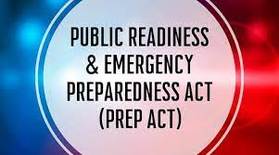
Federal Laws: HHS PREP ACT Amendments¹⁶
Created a united pathway for:
COVID POCT
by pharmacists, technicians, students
Administration of COVID vaccine
by pharmacists, technicians, students
Interstate practice
by pharmacists (possibly technicians)
RPh Ordering/Administration of COVID therapeutics
Immunity from state laws/rules

Slide 37
Evidence
Legislation/Regulations
Education/Training
Proven safe, effective, and impactful
Vaccine Administration
Multiple credible national and state programs
Multiple states, HHS PREP, multiple examples

Slide 38
Independent Prescriptive Authority

Slide 39
The Continuum of RPh Prescriptive Authority¹⁷

Slide 40
State Laws: Independent Prescribing¹⁸⁻²¹
Alberta (Canada), ID
*Recently Passed Bills: CO, UT, ID

Slide 41
Evidence: Independent Prescribing²²
Effects of pharmacist prescribing on patient outcomes in the hospital setting: a systematic review (15 studies)
RPh
Better cholesterol levels
Blood sugar
Adherence to warfarin dosing/therapeutic range
Decreased ADRs
Less prescribing errors (20-25X less)
Less omissions
Patient satisfaction
Author Conclusion:
“Pharmacists are better at adhering to dosing guidelines when prescribing by protocol and make significantly fewer prescribing errors when charting patients' usual medications on admission to hospital.”

Slide 42
Evidence: Independent Prescribing²³⁻²⁸
RxING (26 wks.):
100 patients, diabetes
A1c reduced from 9.1% to 7.3%
FBG reduced from 198 to 124
RxACTION (24 wks.):
248 patients, blood pressure
Systolic reduced 18.3 mm/Hg, diastolic 8 mm/Hg
RxEACH (12 wks.):
723 patients, CV risk reduction
21% greater relative reduction in estimated risk for CV events
RxOUTMAP:
750 patients, UTIs
RPh arm → 88.6% clinical cure rate

Slide 43
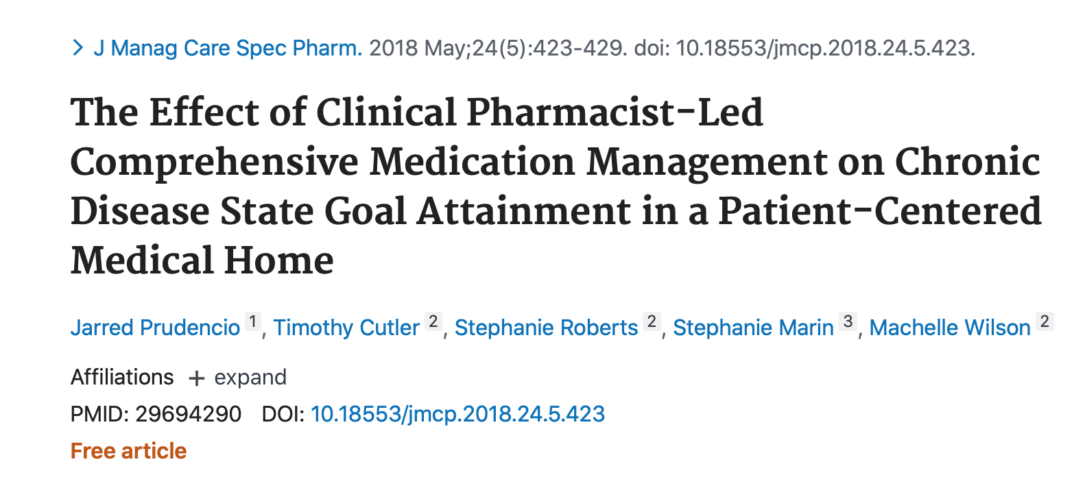
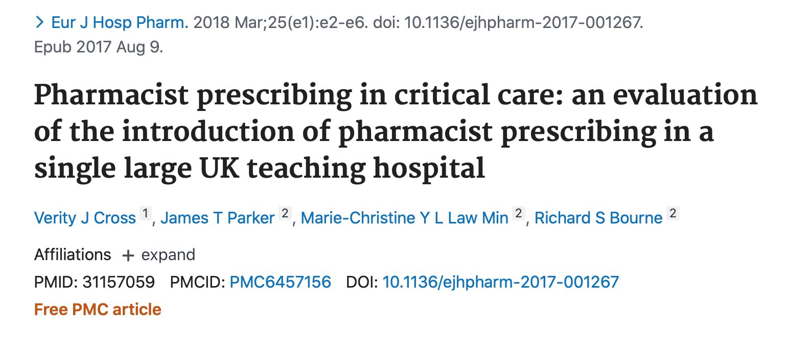
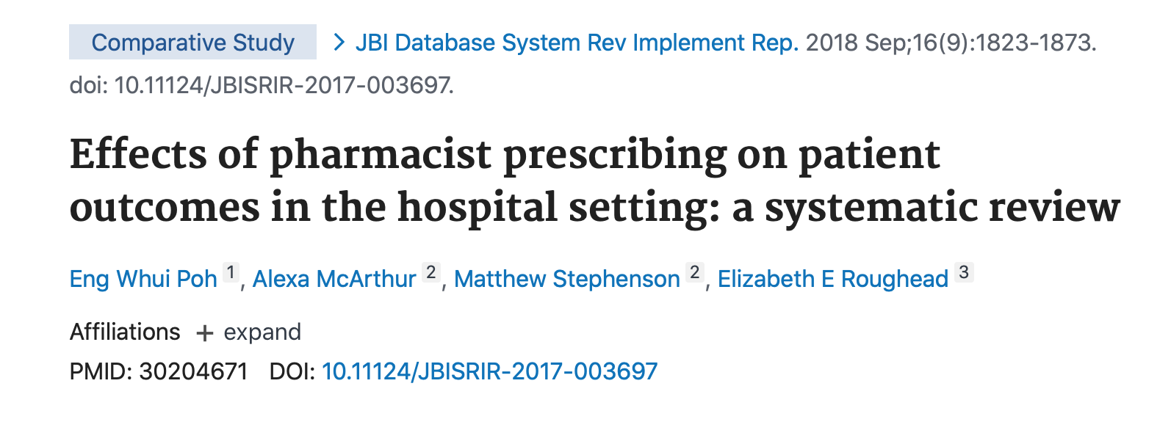
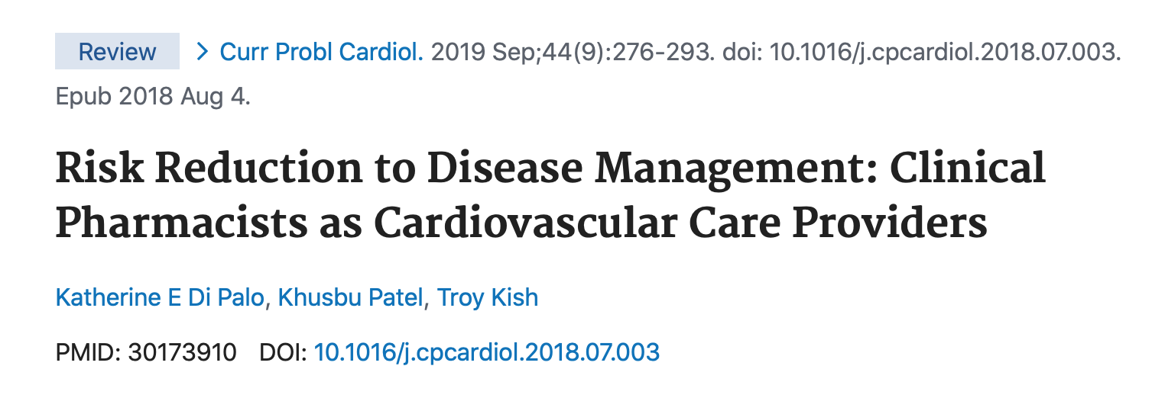

Slide 44
State Laws: RPh Prescribing²⁹
Collaborative Practice
> One Allowed
All Three
Statewide Protocols
Independent Authority

Slide 45
Education & Training
Element | Pharmacy Technician: Reasonable Activity with Training | Pharmacist: Graduated from accredited college and passed NAPLEX
Document during patient assessment | Yes | Yes
Collect vital signs or perform POCT | Yes | Yes
Interpret laboratory tests | Maybe | Yes
Develop a differential diagnosis | No | Yes
Independently select a drug regimen to treat a condition | No | Yes

Slide 46
Evidence
Legislation/Regulations
Education/Training
Proven safe, effective, cost effective, and impactful
Independent Prescriptive Authority
Canada, ID, UT, CO…more to come?
Shift away from
CPA → independent
Employer based, residency, or other opportunity, likely none needed

Slide 47
Telepharmacy

Slide 48
State Laws: Barriers
Milage Restrictions
Facility Restrictions
Staffing Ratios
Interstate Accessibility
Personnel Restrictions

Slide 49
State Laws: Telepharmacy³⁰
Permitted
Prohibited or Not Addressed

Slide 50
State Laws: Head-to-Head
Michigan-SB340 (01/20)
Idaho
10-mile radius restrictions
Avg. < 150 Rx per day
Limit of 3 supervisee pharmacies at a time
Pharmacy technician → 1,000 hours of work experience, licensure, certification…etc.
No milage restrictions
No Rx quantity restrictions
No pharmacy technician restrictions
Video surveillance must be maintained for 90 days
Audio-video → HIPAA compliant

Slide 51
Evidence: Telepharmacy³¹⁻³³
ND Telepharmacy Project
22 publications dating back to 2004
Proven safe and effective
Systematic Reviews
Strnad et al. 2018
Pathak et al. 2021
Jurisdictional Success
20+ years of success in ND
Rural, community, health system
Multiple years of success in various states (without added restrictions)

Slide 52
Evidence: Telepharmacy
Milage Restrictions
Facility Restrictions
Staffing Ratios
Interstate Accessibility
Personnel Restrictions
Non-Evidence Based
Restrictions

Slide 53
Education/Training: Telepharmacy
Employer Specific/Job
APhA Series
NDSU
Telepharm/PiplineRx
Software, Tech, Workflow

Slide 54
Evidence
Legislation/Regulations
Education/Training
Proven safe, effective, and impactful
Telepharmacy
Employer specific,
examples available,
tech/software/workflow
> 50% of states allow but many have restrictions

Slide 55
Full Evidence Based Law Analysis
Evidence
Legislation/Regulations
Education/Training
Patient Needs
Fiscal Impact
Maintaining patient safety: harmonizing scope with abilities
Insert Ability/Role

Slide 56
The COVID MAP
Pharmacy Practice Allowance Increases due to COVID-19 law/rule changes

Slide 57
Today’s Agenda
EBL Analysis of Regs/Legs
SOC/BLR and Licensure
Summary
Barriers to Full Scope

Slide 58
The Big Question
How might we maintain patient safety while harmonizing scope of practice with clinical/technical abilities?

Slide 59
Evidence Based Law Analysis⁴

Slide 60
What Can We Do?
Laws:
Remove the “RED TAPE”
Just because you won’t/can’t, doesn’t mean others won’t/can’t
Work with State Associations, BOP, Legislators, Stakeholders
Evidence:
Educate and disseminate studies, evidence, and historical successes
Learn from other states/models
Evidence based decisions > Emotional
Education/Training:
Tools/Resources available
Appropriate, but not ”shackling”
Instead of fighting each other let’s work together!

Slide 61
What Can You Do?
Work to expand your practice sites based on other successful models
Utilize pilot programs, research projects, or other experimental opportunities
Be conscious of emotions and don’t let the emotions overtake evidence in decision making
Advocate and support for evidenced based legislation/rule changes → no matter the sector in pharmacy

Slide 62
“You don’t run a race for the journey, you run it to arrive.”
-Tim Grover

Slide 63
Q & A
Deeb D. Eid, Pharm.D., RPh
Regulatory Affairs Advisor
deeb.eid@gmail.com

