Slide 1
IDSA 2021 C. difficile Infection Guideline Update
WMSHP Spring Seminar 2022
Benjamin Pontefract, PharmD, BCPS
Ferris State University College of Pharmacy

Slide 2
I do not have any conflicts of interest to disclose

Slide 3
Learning Objectives
Design a treatment regimen for an initial case of C. difficile infection based on patient-specific characteristics
Describe the literature comparing fidaxomicin to vancomycin for recurrent C. difficile infection
Identify a patient who should be considered for bezlotoxumab therapy

Slide 4
C. difficile Infection Background
WMSHP Spring Seminar 2022
Benjamin Pontefract, PharmD, BCPS
Ferris State University College of Pharmacy

Slide 5
Clostridioides difficile Infection
Gram-positive spore-forming anaerobic bacteria
Initial cure rate of ~90%
Recurrence occurs in 15-50% of cases
New CDI within 8 weeks of therapy
Each recurrence increases risk of future recurrences
CDC. Phil.cdc.gov. 2004. Accessed January 27, 2019.
Notes:
For CDI, resistance and lack of initial cure is not the primary issue. While resistance can occur, it is rare. Instead, we concern ourselves with recurrence. So, innovations and advancements in CDI management are targeting a decreased rate of recurrence.
15 to 50% is a pretty big range for recurrence, and that depends on whether the patient has risk factors or not (advanced age, several previous cases of recurrent CDI, etc.).

Slide 6
2021 CDI Guideline Update
WMSHP Spring Seminar 2022
Benjamin Pontefract, PharmD, BCPS
Ferris State University College of Pharmacy

Slide 7
Initial C. difficile Infection (CDI) Treatment
 | 2018 Guidelines | 2021 Guidelines
Non-severe | Vancomycin 125 mg PO QID x 10 days Fidaxomicin 200 mg PO BID x 10 days *Metronidazole 500 mg PO TID is an option if the others aren’t available | First line: Fidaxomicin 200 mg PO BID x 10 days Alternatives: Vancomycin 125 mg PO QID x 10 days *Metronidazole 500 mg PO TID x 10 days only if non-severe and other options are not available
Severe | Vancomycin 125 mg PO QID x 10 days Fidaxomicin 200 mg PO BID x 10 days
Fulminant | Vancomycin 500 mg PO QID + Metronidazole 500 mg IV TID +/- Rectal Vancomycin | Vancomycin 500 mg PO QID + Metronidazole 500 mg IV TID +/- Vancomycin enema per rectum
McDonald LC, et al. Clin Infect Dis 2018;cix1085.
Johnson S, et al Clin Infect Dis 2021;73(5).e1029-e1044.

Slide 8
Recurrent CDI (rCDI) Treatment
 | 2018 Guidelines | 2021 Guidelines
1st Recurrence | Vancomycin 125 mg PO QID x 10 days only if metronidazole was used Fidaxomicin 200 mg PO BID x 10 days if fidaxomicin was not used Vancomycin tapered or pulsed | First Line Fidaxomicin taper Fidaxomicin 200 mg BID x 10 days if not used initially Alternatives Vancomycin 125 mg PO QID x 10 days if not used initially Vancomycin taper
2nd+ Recurrence | Same as above Fecal microbiota transplantation | Vancomycin taper if not used previously Fidaxomicin taper if not used previously Vancomycin 125 mg QID x 10 days followed by rifaximin 400 mg TID x 20 days Fecal microbiota transplantation
McDonald LC, et al. Clin Infect Dis 2018;cix1085.
Johnson S, et al Clin Infect Dis 2021;73(5).e1029-e1044.

Slide 9
Bezlotoxumab 2021 Guideline Recommendations
Bezlotoxumab is recommended for:
Patients with rCDI and CDI episode in the past 6 months
Never use as monotherapy
Should only be an adjunct to normal CDI treatment
Johnson S, et al Clin Infect Dis 2021;73(5).e1029-e1044. doi: 10.1093/cid/ciab549.
Notes:
Since fidaxomicin is now recommended 1st line for everything CDI (both initial and recurrent cases), it is odd that the IDSA also recommends using bezlotoxumab for the majority of our rCDI cases as well.

Slide 10
Clinical Scenario
You are working at your community pharmacy. It is 5:00 PM on a Friday. A patient walks up to your counter with a prescription for fidaxomicin for C. difficile infection. You fill their prescription and tell them that their insurance does not cover that medication. You tell them it will be $5,000 and look up from the cash register to see this face:
How do you proceed?
Notes:
This is the scenario that I fear. A patient needs to be treated for CDI, it’s the afternoon on a Friday, and they are unable to afford their CDI treatment. I personally do not have an answer to how to proceed here. Do you give them a few days of fidaxomicin on the house and call the physician when they’re open on Monday? Do you give them PO vancomycin or metronidazole instead? Do you give them nothing and tell them to go to the ED?
This is the possible downside of having fidaxomicin as the first line agent for CDI. A physician who is unaware of the cost may prescribe it for their patients who cannot afford it. These patients may then end up without care for extended periods of time. So, if this is the downside, what is the possible benefit of this? That leads me into our next slide.

Slide 11
Burning Questions
Is fidaxomicin more effective than vancomycin for initial CDI?
Is it cost effective?
Is fidaxomicin more effective than vancomycin for recurrent CDI?
Is it cost effective?
Is bezlotoxumab effective in the treatment of recurrent CDI?
Is it cost effective?
Johnson S, et al Clin Infect Dis 2021;73(5).e1029-e1044. doi: 10.1093/cid/ciab549.
Notes:
Since fidaxomicin is now recommended 1st line for everything CDI (both initial and recurrent cases), it is odd that the IDSA also recommends using bezlotoxumab for the majority of our rCDI cases as well.

Slide 12
Initial CDI Treatment: Fidaxomicin vs Vancomycin
WMSHP Spring Seminar 2022
Benjamin Pontefract, PharmD, BCPS
Ferris State University College of Pharmacy

Slide 13
Fidaxomicin
Macrolide-class antibiotic with limited spectrum of activity
Primarily active against Clostridia spp.
Theoretically, fidaxomicin’s spectrum of activity decreases recurrence
Less collateral damage to normal GI flora
Incredibly expensive!
Metronidazole PO: $24
Vancomycin PO: $228
Fidaxomicin PO: $5,370
Mikamo H, et al. J Infect Chemother. 2018;24(9):744-752.
Notes:
Prices for all medications here are using average wholesale prices (AWP) from Lexicomp. I calculated how much it would cost for a treatment course for initial CDI.

Slide 14
IDSA Guildeline Cited Studies Initial CDI: Fidaxomicin vs Vancomycin
Louie TJ, et al
Non-inferiority trial comparing fidaxomicin to vancomycin in patients with CDI
Non-inferiority demonstrated for clinical cure
Cornely OA, et al
Non-inferiority trial comparing fidaxomicin to vancomycin in patients with CDI
Non-inferiority demonstrated for clinical cure
Guery B, et al
Superiority trial comparing tapered fidaxomicin to vancomycin in patients with CDI
Higher sustained cure at 30 and 90 days seen in the tapered fidaxomicin group
Mikamo H, et al
Non-inferiority trial comparing fidaxomicin to vancomycin in patients with CDI
Non-inferiority was not demonstrated
All 4 studies included all patients with CDI (did not differentiate between CDI and rCDI)
Between 10-20% of patients in each study had a case of CDI in the past 3 months
Louie TJ, et al. N Engl J Med. 2011;364:422-31.
Cornely OA, et al. Lancet Infect Dis 2012;12:281-9.
Guery B, et al. Lancet Infect Dis 2017;18(3).296-307.
Mikamo H, et al. J Infect Chemother 2018;24:744-52.
Notes:
The first 2 studies were available for the 2018 IDSA guidelines and helped make fidaxomicin a recommendation equal to vancomycin for initial CDI. The second 2 studies are new to the 2021 guidelines and helped the IDSA decide that fidaxomicin should be recommended over vancomycin. We’ll look into these in further detail.
One thing I want to point out, that I think gets ignored about this literature (especially in the IDSA guidelines), is that these studies did not exclusively include patients with initial CDI. Every single one of these studies accepted patients who had an episode of CDI in the past 3 months. It is unclear how many of those patients had a case of CDI in the past 8 weeks, but it was likely a fair number of them did. In all of these studies between 15-20%

Slide 15
IDSA 2021 Guidelines Initial CDI: Fidaxomicin vs Vancomycin
Rate of initial cure within 2 days of end of treatment:
HR (95% CI): 1.00 (0.96 to 1.04)
Drug-related adverse events:
HR (95% CI): 1.02 (0.76 to 1.36)
All-cause mortality:
HR (95% CI): 0.90 (0.66 to 1.23)
No recurrence 4 weeks after end of treatment:
HR (95% CI): 1.16 (1.09 to 1.24)
Johnson S, et al Clin Infect Dis 2021;73(5).e1029-e1044.
Notes:
In this new version of the guidelines, the authors combined the results of those 4 different studies together to create this aggregate data. They essentially do a mini meta-analysis. These are the results. As you can see the only real difference seen is that with fidaxomicin, there is fewer recurrences than with vancomycin.
Let’s take a step back for a minute and think about this because this is very odd…

Slide 16
IDSA 2021 Guidelines Initial CDI: Fidaxomicin vs Vancomycin
Current literature does not clearly support fidaxomicin over vancomycin
Authors creates a meta-analysis to show fidaxomicin’s superiority over vancomycin
Authors publish this meta-analysis as a table in their new guidelines without full scrutiny of their methods
IDSA Guidelines now recommend fidaxomicin over vancomycin for initial CDI
Notes:
Is this a normal and acceptable thing to do? Should the authors of guidelines be running their own statistical analysis (again, not peer reviewed) in order to promote the use of one medication over another?

Slide 17
The New Studies
Guery B, et al
Superiority trial comparing tapered fidaxomicin to vancomycin in patients with CDI
Higher sustained cure at 30 and 90 days seen in the tapered fidaxomicin group
Mikamo H, et al
Non-inferiority trial comparing fidaxomicin to vancomycin in patients with CDI
Non-inferiority was not demonstrated
Guery B, et al. Lancet Infect Dis 2017;18(3).296-307.
Mikamo H, et al. J Infect Chemother 2018;24:744-52.
Notes:
The first 2 studies were available for the 2018 IDSA guidelines and helped make fidaxomicin a recommendation equal to vancomycin for initial CDI. The second 2 studies are new to the 2021 guidelines and helped the IDSA decide that fidaxomicin should be recommended over vancomycin. We’ll look into these in further detail.
One thing I want to point out, that I think gets ignored about this literature (especially in the IDSA guidelines), is that these studies did not exclusively include patients with initial CDI. Every single one of these studies accepted patients who had an episode of CDI in the past 3 months. It is unclear how many of those patients had a case of CDI in the past 8 weeks, but it was likely a fair number of them did. In all of these studies between 15-20%

Slide 18
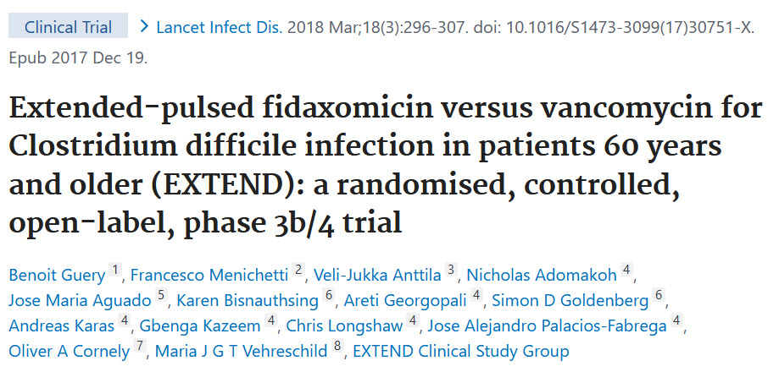
EXTEND Trial
Guery B, et al. Lancet Infect Dis 2017;18(3).296-307.
Notes:
The new CDI guidelines cite the previous studies that contributed to them recognizing fidaxomicin as a possible 1st line agent along with vancomycin. These guidelines also cite 2 new RCTs that are used to support fidaxomicin use OVER vancomycin. Let’s briefly take a look at these studies in further detail.

Slide 19
EXTEND Trial
Compared pulsed fidaxomicin to vancomycin
Fidaxomicin 200 mg bid x 5 days => 200 mg every other day x 20 days
Vancomycin 125 mg QID x 10 days
Demographic | Fidaxomicin (n=177) | Vancomycin (n=179)
Female Gender | 107 (60%) | 100 (56%)
White Race | 149 (84%) | 153 (85%)
Non-severe CDI | 114 (64%) | 112 (63%)
No CDI in Past 3 Months | 141 (80%) | 140 (78%)
Guery B, et al. Lancet Infect Dis 2017;18(3).296-307.
Notes:
The baseline characteristics were similar between groups. Of note, while the majority of patients did not have a recurrent episode of CDI, some of them did. This is not ideal when we are trying to use this study to justify fidaxomicin for use initial CDI over vancomycin.
Also of note, the fidaxomicin used in this study is pulsed fidaxomicin, not a normal regimen. Again, this is not routinely done for initial fidaxomicin.

Slide 20
EXTEND Trial Results
Outcome | Pulsed Fidaxomicin | Standard Vancomycin | P-value
Initial Clinical Cure | 80% (142/177) | 82% (147/179) | 0.721
30-day Sustained Cure* | 70% (124/177) | 59% (106/179) | 0.030
90-day Sustained Cure | 66% (116/177) | 51% (92/179) | 0.007
*Primary Outcome
Guery B, et al. Lancet Infect Dis 2017;18(3).296-307.
Notes:
There was better sustained cure at 30-days (and 90-days) in this study, but again, I want to stress that pulsed fidaxomicin is not what is routinely done for initial CDI patients. Also, that is not what is recommended per the guidelines at this time for initial CDI. That with how ~20% of patients had recurrence CDI makes this study had poor external validity.

Slide 21
EXTEND Summary
Fidaxomicin taper was superior to standard dose vancomycin
For sustained cure
Fidaxomicin taper is not recommended for initial CDI
Included patients with possible rCDI
~20% of patients had CDI in the past 3 months
Did not state how many patients had rCDI (also did not exclude them)
Guery B, et al. Lancet Infect Dis 2017;18(3).296-307.
Notes:
There was better sustained cure at 30-days (and 90-days) in this study, but again, I want to stress that pulsed fidaxomicin is not what is routinely done for initial CDI patients. Also, that is not what is recommended per the guidelines at this time for initial CDI. That with how ~20% of patients had recurrence CDI makes this study had poor external validity.

Slide 22
The New Studies
Guery B, et al
Superiority trial comparing tapered fidaxomicin to vancomycin in patients with CDI
Higher sustained cure at 30 and 90 days seen in the tapered fidaxomicin group
Mikamo H, et al
Non-inferiority trial comparing fidaxomicin to vancomycin in patients with CDI
Non-inferiority was not demonstrated
Guery B, et al. Lancet Infect Dis 2017;18(3).296-307.
Mikamo H, et al. J Infect Chemother 2018;24:744-52.
Notes:
The first 2 studies were available for the 2018 IDSA guidelines and helped make fidaxomicin a recommendation equal to vancomycin for initial CDI. The second 2 studies are new to the 2021 guidelines and helped the IDSA decide that fidaxomicin should be recommended over vancomycin. We’ll look into these in further detail.
One thing I want to point out, that I think gets ignored about this literature (especially in the IDSA guidelines), is that these studies did not exclusively include patients with initial CDI. Every single one of these studies accepted patients who had an episode of CDI in the past 3 months. It is unclear how many of those patients had a case of CDI in the past 8 weeks, but it was likely a fair number of them did. In all of these studies between 15-20%

Slide 23
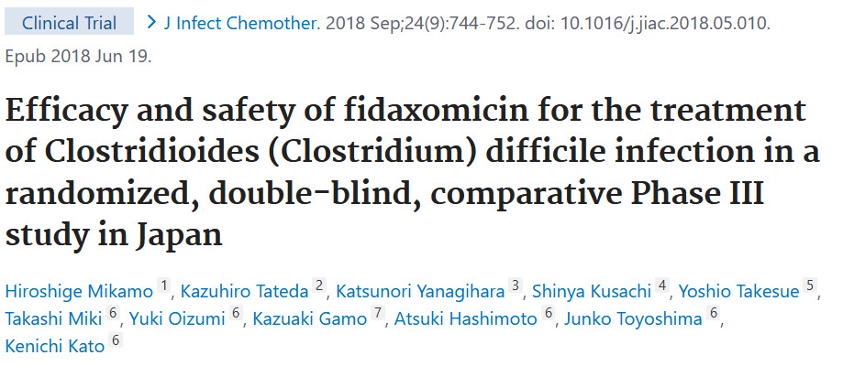
Initial CDI Treatment Literature
Mikamo H, et al. J Infect Chemother. 2018;24(9):744-752.
Notes:
This is the second newer RCT comparing fidaxomicin to vancomycin.

Slide 24
Mikoma et al Methods
Non-inferiority trial comparing fidaxomicin to vancomycin
Both at standard doses
10% non-inferiority margin was defined
Primary outcome:
Global cure: cure at end of treatment AND had no recurrence during follow-up
Secondary outcome:
Clinical cure at end of treatment (EOT)
Recurrence at end of follow-up
Only for patients who had initial clinical cure
Mikamo H, et al. J Infect Chemother. 2018;24(9):744-752.

Slide 25
Mikoma et al Results
Results comparing fidaxomicin to vancomycin
Outcome | Fidaxomicin | Vancomycin | OR (+95% CI)
Global Cure | 67.3% (70/104) | 65.7% (71/108) | 1.2 (-11.3, 13.7)
Cure at EOT | 83.7% (87/104) | 88.0% (95/108) | -4.4 (-13.7, 5.0)
Recurrence at follow-up | 19.5% (17/87) | 25.3% (24/95) | -4.9 (-16.7, 7.0)
Mikamo H, et al. J Infect Chemother. 2018;24(9):744-752.
Notes:
Here are the results to Mikoma et al. Note that the denominator for recurrence at follow-up is different because it is only including patients who did have cure at end of treatment (EOT).
Of note, there are no statistically significant differences between the groups. As this was a non-inferiority trial, we need to look at the top confidence interval for global cure. Since the non-inferiority margin was set at 10% and the interval reached above 10%, non-inferiority was not demonstrated.
There is a trend towards recurrence decreased at follow-up with fidaxomicin, but this was not statistically significant. This study was also not designed to demonstrate superiority.

Slide 26
Mikoma et al Summary
Primary outcome was global cure
Global cure: initial cure and sustained cure by the end of therapy
Compared standard dose fidaxomicin to standard dose vancomycin
No difference was seen in:
Global cure
Cure at end of therapy
Recurrence at follow-up
Non-inferiority was not demonstrated
Mikamo H, et al. J Infect Chemother. 2018;24(9):744-752.

Slide 27
Fidaxomicin Vs Vancomycin Initial CDI Treatment
Rate of initial cure within 2 days of end of treatment:
HR (95% CI): 1.00 (0.96 to 1.04)
Drug-related adverse events:
HR (95% CI): 1.02 (0.76 to 1.36)
All-cause mortality:
HR (95% CI): 0.90 (0.66 to 1.23)
No recurrence 4 weeks after end of treatment:
HR (95% CI): 1.16 (1.09 to 1.24)
Johnson S, et al Clin Infect Dis 2021;73(5).e1029-e1044.
Notes:
Let’s return to the IDSA’s combination of the results on these studies. While the IDSA’s analysis looks very compelling, when you peel back the layers of the studies they actually included, it leaves a LOT to be desired. When evaluating this, you need to evaluate it in a similar manner to meta-analyses. You need to look at the actual studies to determine if they are high quality. If you are putting in bad data, the results you get out will also be flawed.

Slide 28
Critiques of the IDSA’s Initial CDI Study Analysis
The analysis included the EXTEND trial
Tapered fidaxomicin is NOT routinely used to treat initial CDI
10-20% of patients had CDI in the past 3 months
Unclear how many of these met the definition of recurrent CDI
A study dedicated to this clinical question is needed
Fidaxomicin x 10 days vs. vancomycin x 10 days
Exclude patients with recurrent CDI
Mikamo H, et al. J Infect Chemother. 2018;24(9):744-752.
Notes:
While the IDSA’s analysis looks very compelling, when you peel back the layers of the studies they actually included, it leaves a LOT to be desired. When evaluating this, you need to evaluate it in a similar manner to meta-analyses. You need to look at the actual studies to determine if they are high quality. If you are putting in bad data, the results you get out will also be flawed.
Of note, this data DOES include the EXTEND trial, which utilized a fidaxomicin taper, which is NOT what is recommended by the guidelines and also is not routinely used in initial CDI. ALSO, remember that 15-20% of the patients included in this analysis had recurrent CDI. I would argue the results of this analysis are willfully ignorant at best and purposefully misleading at worst.

Slide 29
Fidaxomicin Vs Vancomycin Initial CDI Treatment Cost Analysis
Cost to treat an initial CDI episode:
$5,370 for a course of fidaxomicin vs $228 for vancomycin
Cost-benefit analyses on the topic are mixed
Favor fidaxomicin: 2
Neutral: 2
Does not favor fidaxomicin: 1
Johnson S, et al Clin Infect Dis 2021;73(5).e1029-e1044.
Notes:
Pharmacoeconomic studies are hard to create and even harder to evaluate. They require a lot of estimating. You need to estimate how often a negative outcome will occur. You then must estimate how much each one of those outcomes cost. Then, you need to estimate how many quality-adjusted life years (QALYs) the average patient saves. Then you need to estimate how much money you think a QALY is worth. Needless to say, there is a lot of bias that is hard to eliminate no matter how neutral of a party is conducting the study. Also, it’s important to note here that these studies are all assuming that fidaxomicin reduces rates of recurrence for CDI, which, as we just discussed, has not clearly been established.
Of note here, these studies are assuming that fidaxomicin causes a significant decrease in recurrence. Based on the last 2 studies we looked at, I’m not sure you can confidently say that for the recommended fidaxomicin dosing of 100 mg bid.

Slide 30
Risk Factors for C. difficile Recurrence
Age >65 years or older
Compromised immunity
Severe C. difficile infection
Infection with ribotype 027/078/244
Wilcox MH, et al N Engl J Med. 2017;376:305-17.
Gerding DN, et al. Clin Infect Dis 2018;67:649-56.
Notes:
These are the reported risk factors that puts someone at high risk for C. difficile recurrence. Given the high price of fidaxomicin, I would recommend reserving it for the time being to high risk patients. With that said, there are no studies looking at whether fidaxomicin is more effective in these populations compared to vancomycin.

Slide 31
Initial C. difficile Treatment Summary
Fidaxomicin is recommended first line per IDSA guidelines
For non-severe or severe CDI
Fidaxomicin can be prohibitively expensive for patients
If patient can’t afford fidaxomicin, vancomycin is still effective
Consider fidaxomicin if patients are high risk for recurrence
Consider vancomycin if patient is low risk for recurrence
Notes:
These are the reported risk factors that puts someone at high risk for C. difficile recurrence. Given the high price of fidaxomicin, I would recommend reserving it for the time being to high risk patients. With that said, there are no studies looking at whether fidaxomicin is more effective in these populations compared to vancomycin.

Slide 32
Recurrent CDI Fidaxomicin vs Vancomycin
WMSHP Spring Seminar 2022
Benjamin Pontefract, PharmD, BCPS
Ferris State University College of Pharmacy

Slide 33
rCDI Literature
Fidaxomicin may have a decrease in recurrence
Louie, et al
Cornely, et al
Guery, et al (EXTEND trial)
These data is all from subgroup analyses of these studies
Compared fidaxomicin x 10 days or taper to vancomycin x 10 days
Louie TJ, et al. N Engl J Med. 2011;364:422-31.
Cornely OA, et al. Lancet Infect Dis 2012;12:281-9.
Guery B, et al. Lancest Infect Dis 2018;18:296-307.
Johnson S, et al Clin Infect Dis 2021;73(5).e1029-e1044. doi: 10.1093/cid/ciab549.
Notes:
Here are the studies that are evaluated by the authors here. These names may look familiar, and that’s because they are! These are the first 3 studies that were used in the IDSA’s analysis of fidaxomicin for the treatment of initial CDI.
We unfortunately do not have time to dissect any of these studies in terms of rCDI treatment. I think the argument to use fidaxomicin for rCDI is stronger than it is for initial CDI. That mainly comes down to how we don’t really have data to support vancomycin tapers. There is some data to support fidaxomicin for rCDI. Unfortunately, all of the data here are subgroup analyses. So, still not the strongest data available. I also think a dedicated study needs to be conducted for this clinical question as well.
Guery compared fidaxomicin taper to vancomycin x 10 days

Slide 34
Fidaxomicin Vs Vancomycin rCDI Treatment
Rate of initial cure within 2 days of end of treatment:
HR (95% CI): 1.03 (0.94 to 1.14)
Drug-related adverse events:
HR (95% CI): 0.68 (0.35 to 1.29)
All-cause mortality:
HR (95% CI): 0.81 (0.20 to 3.38)
No recurrence 30 days after end of treatment:
HR (95% CI): 1.27 (1.05 to 1.54)
No recurrence 90 days after end of treatment
HR (95% CI): 1.56 (0.99 to 2.44)
Johnson S, et al Clin Infect Dis 2021;73(5).e1029-e1044.
Notes:
Again, the authors of these guidelines did their own analysis of the data that is available for recurrent CDI. The only clear benefit is a reduction in recurrence. Again though, the timeline here isn’t perfect. Recurrent CDI is defined as a case of CDI within 8 weeks (56 days) of a previous episode. Here, the IDSA reports a difference at 30 days, but not at 90 days. So, does fidaxomicin actually reduce rates of “recurrent CDI”? We actually can’t say whether it does or not. The data does not clearly tell us that.

Slide 35
Fidaxomicin Vs Vancomycin rCDI Treatment
Fidaxomicin is significantly more expensive
Cost to treat an rCDI episode:
$5,370 for a course of fidaxomicin vs $299 for vancomycin
Limited cost-benefit analyses exist on this topic
Favor fidaxomicin: 3 (2 are sponsored by the manufacturer)
Does not favor fidaxomicin: 1
Johnson S, et al Clin Infect Dis 2021;73(5).e1029-e1044.
Notes:
My cost estimates here for vanco are based on a taper of taper of 125 mg QID x 14 days => 125 mg BID x 7 days => 125 mg q24hr x 7 days => 125 mg every other days x 14 days. This totals 10,500 mg of vancomycin. The AWP of oral vanco solution is $1.14 per 50 mg.
My cost estimates for fidaxomicin are based on a taper of 200 mg bid x 5 days => 200 mg every other day x 20 days. This total 4000 mg of fidaxomicin. The AWP of fidaxomicin is $268.51 per 200 mg.
Again, we are assuming that fidaxomicin has a clinically significant difference here, which we do not have definitive proof of.

Slide 36
rCDI Literature
All data for rCDI are:
Subgroup analyses
Comparing fidaxomicin x 10 days or taper to vancomycin x 10 days
Data surrounding vancomycin tapers is lacking
Need a study focused on rCDI comparing:
Fidaxomicin x 10 days or taper to vancomycin taper
Louie TJ, et al. N Engl J Med. 2011;364:422-31.
Cornely OA, et al. Lancet Infect Dis 2012;12:281-9.
Guery B, et al. Lancest Infect Dis 2018;18:296-307.
Johnson S, et al Clin Infect Dis 2021;73(5).e1029-e1044. doi: 10.1093/cid/ciab549.
Notes:
Here are the studies that are evaluated by the authors here. These names may look familiar, and that’s because they are! These are the first 3 studies that were used in the IDSA’s analysis of fidaxomicin for the treatment of initial CDI.
We unfortunately do not have time to dissect any of these studies in terms of rCDI treatment. I think the argument to use fidaxomicin for rCDI is stronger than it is for initial CDI. That mainly comes down to how we don’t really have data to support vancomycin tapers. There is some data to support fidaxomicin for rCDI. Unfortunately, all of the data here are subgroup analyses. So, still not the strongest data available. I also think a dedicated study needs to be conducted for this clinical question as well.
Guery compared fidaxomicin taper to vancomycin x 10 days

Slide 37
Vancomycin or Fidaxomicin Ultimate Conclusion
Both are effective for CDI and rCDI
Fidaxomicin likely has a lower rate of recurrence
Most studies at least trend towards fidaxomicin having less recurrence
Fidaxomicin is significantly more expensive
Most patients will have trouble affording fidaxomicin
Most cost-effective option is unclear
I prefer vancomycin over fidaxomicin for initial CDI
Until stronger data is available
Until fidaxomicin becomes more affordable for patients
I consider fidaxomicin in patients with:
Significant risk factors for recurrence
Recurrent CDI episode
Excellent insurance
Notes:
Anecdotally, I have spoken with students of mine who work in community pharmacies. They have seen patients patient several thousand dollars for a course of fidaxomicin.
I personally feel ok about using fidaxomicin in patients with rCDI

Slide 38
Bezlotoxumab
WMSHP Spring Seminar 2022
Benjamin Pontefract, PharmD, BCPS
Ferris State University College of Pharmacy

Slide 39
Bezlotoxumab
Monoclonal antibody for toxin B
Decreases risk of recurrence
Costs $4560 per treatment course

Slide 40
Bezlotoxumab Literature Review
Guidelines cite 2 studies:
Wilcox et al (MODIFY I and MODIFY II Trials)
Gerding et al
Post-hoc analysis of MODIFY I and MODIFY II
Majority of patients received vancomycin or metronidazole
1.6% - 4.6% received fidaxomicin
Johnson S, et al Clin Infect Dis 2021;73(5).e1029-e1044. doi: 10.1093/cid/ciab549.
Wilcox MH, et al. N Engl J Med. 2017;376:305-17.
Gerding DN, et al. Clin Infect Dis 2018;67:649-56.
Notes:
Since fidaxomicin is now recommended 1st line for everything CDI (both initial and recurrent cases), it is odd that the IDSA also recommends using bezlotoxumab for the majority of our rCDI cases as well.

Slide 41
MODIFY I and MODIFY II
Randomized, double-blind, placebo-controlled trial
322 sites in 30 countries
Included initial or recurrence cases of CDI
Number of cases that were initial or recurrent was not reported
25% of patients had a CDI episode in the past 6 months
Merck representatives participated in:
Study design
Statistical analysis
Manuscript drafting
Wilcox MH, et al. N Engl J Med. 2017;376:305-17.
Notes:
Since fidaxomicin is now recommended 1st line for everything CDI (both initial and recurrent cases), it is odd that the IDSA also recommends using bezlotoxumab for the majority of our rCDI cases as well.

Slide 42
MODIFY I and II Results
Study | Endpoint | Groups | Result | P-value
MODIFY-I | Recurrence within 12 weeks | SOC + bezlotoxumab | 17% | P<0.001
 |  | SOC alone | 28%
MODIFY-II | Recurrence within 12 weeks | SOC + bezlotoxumab | 16% | P<0.001
 |  | SOC alone | 26%
Johnson S, et al Clin Infect Dis 2021;73(5).e1029-e1044. doi: 10.1093/cid/ciab549.
Wilcox MH, et al. N Engl J Med. 2017;376:305-17.
Notes:
Here are a very abbreviated version of the results from the MODIFY-I and MODIFY-II trials. Both looked at recurrence within 12 weeks (rCDI is defined as another infection within 8 weeks). There were fewer in the bezlotoxumab rm in both studies.

Slide 43
Bezlotoxumab Literature Review
Guidelines cite 2 studies:
Wilcox et al (MODIFY I and MODIFY II Trials)
Gerding et al
Johnson S, et al Clin Infect Dis 2021;73(5).e1029-e1044. doi: 10.1093/cid/ciab549.
Wilcox MH, et al. N Engl J Med. 2017;376:305-17.
Gerding DN, et al. Clin Infect Dis 2018;67:649-56.
Notes:
Since fidaxomicin is now recommended 1st line for everything CDI (both initial and recurrent cases), it is odd that the IDSA also recommends using bezlotoxumab for the majority of our rCDI cases as well.

Slide 44
Gerding et al
Post-hoc analysis of MODIFY I and MODIFY II
Confirmed bezlotoxumab is effective in high-risk patients
Age > 65 years
Immunocompromised
Severe CDI
Is where the recommendation timing originated:
Use bezlotoxumab in patients with CDI in the past 6 months
Johnson S, et al Clin Infect Dis 2021;73(5).e1029-e1044. doi: 10.1093/cid/ciab549.
Gerding DN, et al. Clin Infect Dis 2018;67:649-56.
Notes:
Gerding essentially analyzed the previous study to investigate whether bezlotoxumab was still effective when looking at patients who are at high risk for recurrence. According to the IDSA’s evaluation of this manuscript, bezlotoxumab was still effective in patients that are high risk for recurrence.

Slide 45
Gerding et al Methods
Post-hoc analysis of MODIFY I and MODIFY II
Randomized, double-blind, placebo-controlled trial
Categorized patients by RFs for recurrence present
Age > 65 years
History of CDI in the previous 6 months
Severe CDI (Zar score > 2 points)
Infection with ribotype 027, 078, 244
Primary outcome:
New CDI within 12 weeks of infusion
Gerding DN, et al. Clin Infect Dis 2018;67:649-56.

Slide 46
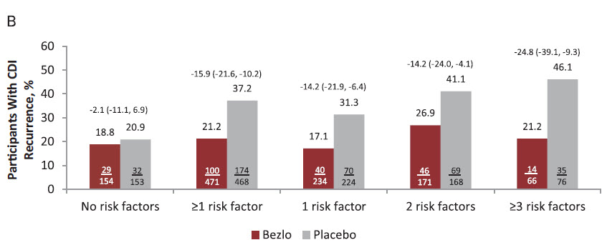
Gerding et al Results
Gerding DN, et al. Clin Infect Dis 2018;67:649-56.
Notes:
Gerding essentially analyzed the previous study to investigate whether bezlotoxumab was still effective when looking at patients who are at high risk for recurrence. According to this analysis, bezlotoxumab was still effective in these patients.

Slide 47
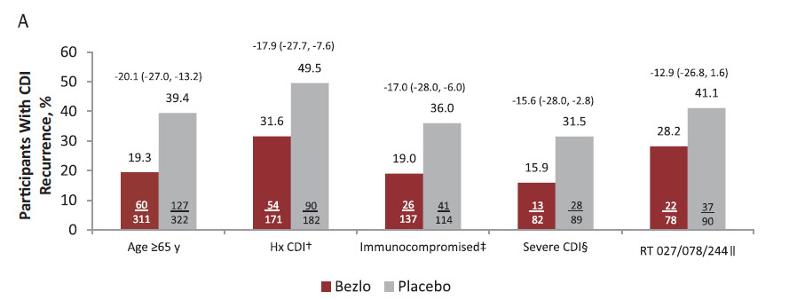
Gerding et al Results
Includes patients with at least this RF
Did not differentiate patients with only any specific RF
Gerding DN, et al. Clin Infect Dis 2018;67:649-56.
Notes:
Gerding essentially analyzed the previous study to investigate whether bezlotoxumab was still effective when looking at patients who are at high risk for recurrence. According to this analysis, bezlotoxumab was still effective in these patients.

Slide 48
Gerding et al Summary
This is a sub-group analysis on top of a post-hoc analysis
High risk for bias
Bezlotoxumab reduces recurrence in select patients:
Patients with at least 1 risk factor for recurrence
Including patients with an episode CDI in the past 6 months
Bezlotoxumab’s efficacy is unclear for each individual RF
Bezlotoxumab is likely effective in all patients with rCDI
Gerding DN, et al. Clin Infect Dis 2018;67:649-56.
Notes:
Gerding essentially analyzed the previous study to investigate whether bezlotoxumab was still effective when looking at patients who are at high risk for recurrence. According to this analysis, bezlotoxumab was still effective in these patients.

Slide 49
Is Bezlotoxumab Cost Effective?
Several cost-benefit analyses exist
Chen J et al compared the following:
Vancomycin PO x 10 days
Fidaxomicin PO x 10 days
Bezlotoxumab x 1 + vancomycin PO x 10 days
Fidaxomicin PO taper (x 25 days total)
Chen J, et al. Clin Microbiol Infect 2021;27(10):1448-1454
Notes:
We aren’t going to talk about fidaxomicin PO taper here just for the sake of time. In summary, fidaxomicin PO taper was also cost effective with a total monetary benefit of $3,248. It was less cost effective than fidaxomicin PO x 10 days likely due to the fact that patients fidaxomicin PO taper were considered to be “diseased” for the duration of the taper (25 days vs 10 days for traditional fidaxomicin dosing). This negatively impacted it’s perceived benefit. This is an example of the issues with pharmacoeconomic studies

Slide 50
Chen et al (Bezlotoxumab Cost Benefit Analysis)
Entirely model-based
No new clinical data was collected
Based on Prabhu et al’s models
U.S. societal perspective
Assumed a WTP:
$150,000 per QALY
Variable | Value
Average age | 62.4 years
Percent age >65 years | 49.5%
Percent Female | 58.2%
Percent Inpatient | 63.4%
Percent Severe CDI | 32.5%
Chen J, et al. Clin Microbiol Infect 2021;27(10):1448-1454
Prabhu VS, et al. Clin Infect Dis 2018;66:355-62.
Notes:
WTP = willingness to pay. So, how much will society be willing to burden itself to gain 1 QALY? Here, it was assumed at $150,000, which is appropriate. The World Health Organization recommends using a WTP of 3x the gross domestic product of the country in question.
QALY is a quality-adjusted life year. The idea here is to give a more nuanced look at the benefit of a medication. For example, if a drug extends your life by 1 year, but you are debilitated and hardly able to move, that would be worth less QALYs than if the medication extended your life by 1 year without any debilitation.

Slide 51
Chen et al (Bezlotoxumab Cost Benefit Analysis)
Medication | Total Cost (to society) | Cost per QALY (vs vanco x 10 days) | Total Monetary Gain (to society) (vs. vanco x 10 days)
Vancomycin | $39,178 | N/A | N/A
Fidaxomicin | $39,325 | $495 | $44,308
Bezlotoxumab + vancomycin | $41,461 | $17,746 | $17,011
Chen J, et al. Clin Microbiol Infect 2021;27(10):1448-1454
Notes:
Here are the overall results of the study. Of note, all of the costs listed here are costs to society. So, it does not include just the medication cost. It also includes health system costs (cost to treat a patient in the hospital). Also again, it includes things such as loss of productivity in society. So, if a patient has to be home sick for a week, it would include that lost money as well.
Cost of vancomycin is very similar to fidaxomicin. Bezlotoxumab + vancomycin is a bit more expensive. What I want to draw everyone’s attention to is the cost per QALY and the total monetary gain of society compared to vancomycin. Both fidaxomicin and bezlotoxumab + vancomycin have a cost per QALY that is well below the $150,000 willingness to pay threshold. Fidaxomicin, in particular, is a lot more cost effective in this regard, compared to bezlotoxumab.

Slide 52
Chen et al Limitations (Bezlotoxumab Cost Benefit Analysis)
Combined non-severe and severe cases into a single model
Did adjust for this
Metronidazole was not included
Combined both initial and recurrent CDI into a single model
Did not adjust for this
Patients with rCDI have a higher risk for further recurrence
Cure rates were based off previous clinical trials
Quality of life for a QALY is not clearly defined
Softer science
Assumes the patient/health system can afford the upfront cost of medications
Chen J, et al. Clin Microbiol Infect 2021;27(10):1448-1454
Notes:
Gerding essentially analyzed the previous study to investigate whether bezlotoxumab was still effective when looking at patients who are at high risk for recurrence. According to this analysis, bezlotoxumab was still effective in these patients.

Slide 53
Chen et al Summary (Bezlotoxumab Cost Benefit Analysis)
From a societal perspective:
Fidaxomicin is cost effective compared to vancomycin
$495 cost per QALY
Bezlotoxumab-vancomycin is cost effective compared to vancomycin
$17,746 cost per QALY
Chen J, et al. Clin Microbiol Infect 2021;27(10):1448-1454
Notes:
Gerding essentially analyzed the previous study to investigate whether bezlotoxumab was still effective when looking at patients who are at high risk for recurrence. According to this analysis, bezlotoxumab was still effective in these patients.

Slide 54
Bezlotoxumab 2021 Guideline Summary
Bezlotoxumab is recommended as adjunct therapy:
Patient with rCDI and CDI episode in the past 6 months
Incredibly expensive
AWP: $4,500 per dose in a non-obese patient
Consider in patients with rCDI and >1 risk factors for recurrence
Age >65 years
Immunocompromised host
Severe CDI on presentation
Little data exists for bezlotoxumab + fidaxomicin
Notes:
Since fidaxomicin is now recommended 1st line for everything CDI (both initial and recurrent cases), it is odd that the IDSA also recommends using bezlotoxumab for the majority of our rCDI cases as well.

Slide 55
American College of Gastroenterology (ACG)
IDSA Guidelines recommend very expensive products
Recommend these products as 1st line agents for all patients
May be beneficial specifically in patients that are high risk for recurrence
The ACG published guidelines in 2021
Initial non-severe CDI: Metronidazole for low risk patients*, vancomycin, or fidaxomicin
Initial severe CDI: Vancomycin or fidaxomicin
Recurrent CDI: Vancomycin taper, fidaxomicin, or fidaxomicin taper
Bezlotoxumab: Only in patients with rCDI
Mikamo H, et al. J Infect Chemother. 2018;24(9):744-752.
Notes:
The IDSA’s guidelines have come under fire for recommending incredibly expensive agents that may not be necessary across the board.
To show that I am not just a lone renegade that has issues with these guidelines, let’s take a brief look at the American College of Gastroenterology recommendations. The ACG came out with their own guidelines a short 4 months prior to the IDSA guidelines. They do not recommend fidaxomicin over vancomycin in any situation. They even recommend metronidazole can still be considered as a first line agent in non-severe CDI in patients that are low risk for recurrence (young patients with few comorbidities), especially if cost is a significant concern.

Slide 56
2021 IDSA CDI Guidelines Summary
Fidaxomicin is 1st line for initial CDI
Data supporting this recommendation is mixed
Consider fidaxomicin in patients at high risk for CDI recurrence with excellent insurance
Consider vancomycin in patients at low risk for CDI recurrence with poor or no insurance
Fidaxomicin is 1st line for recurrent CDI
Data supporting this recommendation is low quality, but the alternatives have less data
Would be great to see a study comparing fidaxomicin to vancomycin taper
Bezlotoxumab is recommended in rCDI
Data including fidaxomicin + bezlotoxumab is limited
Likely most beneficial in patients with > 1 risk factor for recurrence
Fidaxomicin and bezlotoxumab may be the future of CDI treatment
Need to await stronger data before embracing these products
Both are prohibitively expensive to endorse routine use
Possibly use fidaxomicin before using vancomycin + bezlotoxumab (based on pharmacoeconomic data)
Notes:
In summary, fidaxomicin and bezlotoxumab are now both first line agents per the CDI guidelines. I personally believes these guidelines were released prematurely. There data does not clearly show that fidaxomicin is better and more cost effective than vancomycin. From speaking with my students who work in the community setting, they’re seeing patients being charged several thousands of dollars for a course of fidaxomicin. If providers start prescribing this for everyone, I foresee it leading to many patients not receiving the necessary treatment for CDI.
It’s important for everyone to note that vancomycin is still an effective treatment option for eligible patients who cannot afford the more expensive options.

Slide 57
IDSA 2021 C. difficile Infection Guideline Update
WMSHP Spring Seminar 2022
Benjamin Pontefract, PharmD, BCPS
Ferris State University College of Pharmacy

Slide 58
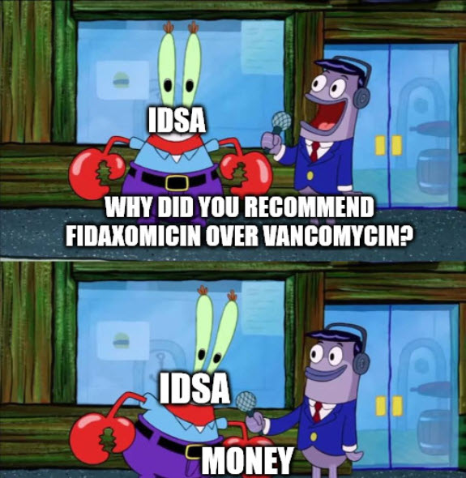
Why Fidaxomicin?
Stuart Johnson, Valery Lavergne, Andrew Skinner, Anne Gonzales-Lune
Kevin W Garey – Consultant/advisor of Merck
Ciaran P Kelly – Advisor for Merck, receives honoraria from Merck to speak at symposiums, receives research funding from Merck
Mark H Wilcox – Advisor for Merck; receives research funding from Merck
Notes:
the mystery is unfortunately not solved. This is a clinical connumdrum to this day, and it will likely remain 1 until either fidaxomicin becomes less expensive (unlikely) or more data becomes available.
Merck makes both fidaxomicin and bezlotoxumab. The widespread recommendation for both of these products is at the forefront of this guideline update.

